Slide 1
Firewire Camera support for Epics

Slide 2
What is 'Firewire'
IEEE1394 or 'firewire' is a high speed serial bus
Up to 400 Mbit/sec
Twisted pair media
Multiple devices on a bus
Up to 10m between devices or repeaters
Longer at slower speed
Standard on most new PCs

Slide 3
Differences to USB
Not 'PC centric' – multiple or no PCs possible
Guaranteed bandwidth (Important for video)

Slide 4
Firewire for Cameras - DCII
Well defined high level protocol over firewire
Supported by many cameras
Low end ($80) to high performance industrial
Protocol includes support for triggering, ROI etc.

Slide 5
Firewire for Linux
Very good support
www.linux1394.org
Support included in newer kernels (>=2.4.18)
Many applications available
Library (libdc1394) for writing your own applications

Slide 6
Firewire for VxWorks
Hardware available as PMC or PCI card
PMC is standard on Motorola PPC processors
Multiple firewire PMC vendors (Mindready, SBC, technobox,Synergy,...)
VxWorks drivers and libraries from Mindready
But Mindready software quite expensive

Slide 7
Firewire for Epics
Device support written for Linux
Uses libdc
Provides
  Camera control
  Image acquisition
  Analysis

Slide 8
Analogue Inputs
brightness, exposure, gain
NumNodes, numCameras,
height, width, hoffset, woffset, size
xp, yp – image center position
xw, yw – image width
xsn, ysn – signal/noise ratio

Slide 9
MBBI
mode
format (Mono, RGB, YUV, depth,size)
framerate

Slide 10
Analogue Outputs
set_height
set_width
set_hoffset
set_woffset
set_gain*
set_exposure*

Slide 11
MBBO
set_mode*
set_format*
set_frame Rate*

Slide 12
Waveform
data – raw image
xdist – sum of each column
ydist – sum of each row

Slide 13
DB file
record(waveform,"camera1:data"){
  field(SCAN,”.1 second”)
  field(DTYP,”1394”)
  field(INP,”#C0 S0 @data”)
  field(NELM,”1000000”)
  field(FTVL,”UCHAR”)
  }
For waveforms set NELM to max posible value, driver will adjust to actual size
Param selects what to return (data, xdist, xp, etc...)

Slide 14
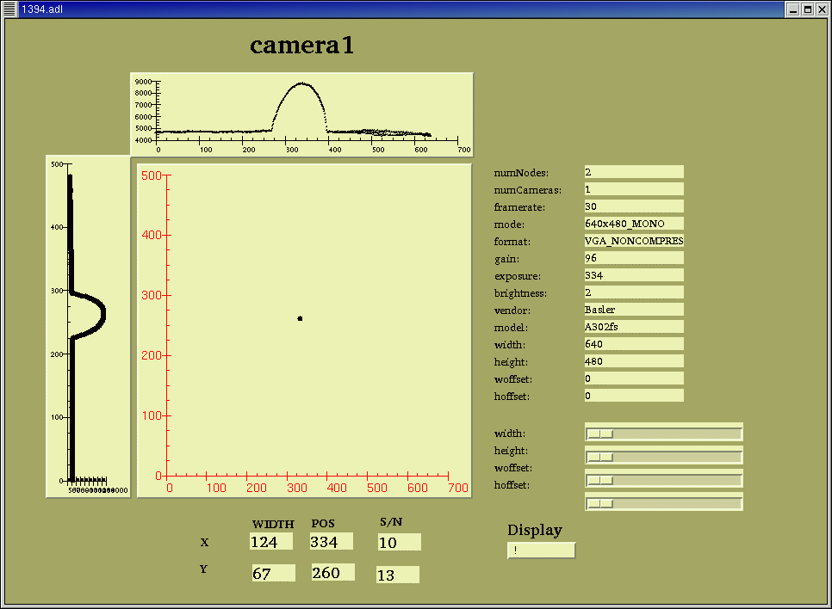
Medm Screen

Slide 15
Image display CA client
X application
Resizes as image width and height changes
10Hz update 640x480 mono uses ~5% of 2.4G P4
Writing image to screen takes ~10mS

Slide 16
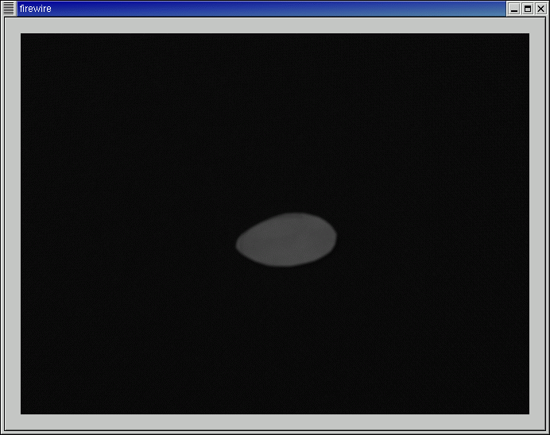
X client

Slide 17
Cameras Tested
Vendor Model Col dep res fs trig cost
Unibrain FireI m/c 8 640x480 30 n $80
Point Grey Flea m 8 1024x768 30 y $800
Basler A302S m 8 782x582 30 y

Slide 18
Radiation resistance
Tests done at SRS booster and NRPI
All cameras worked up to 100 Gy
Repeater worked > 7000 Gy

Slide 19
Problems encountered (minor)
Lack of documentation of libdc (read the .h file)
CA manual (3.14.4) does not match example made by makeBaseApp
Video1394 kernel module (needed for dma mode) did not work on our installation – needed kernel >2.4.21

Slide 20
Further Work
Support all modes
Read status while acquisition running
Change format while acquisition running
DMA mode to improve speed
Interrupt not periodic scan
Image record support (for 3.13 clients)
Auto support for 16bit X servers

Slide 21
Advantages
Beam position, width, quality can be alarmed/archived as well as displayed
Reduced network traffic
Does not rely on operator
No extra electronics required for triggering or image conversion

Slide 22
Example Applications
Auto beam alignment
Injection optimization
Pinhole array analysis
emittance measurement
Auto sample centering
???

